Slide 1


Debris Disk Detection around Nearby Stars
Elizabeth Gehret
Mentor: Dr. David Koerner
Northern Arizona University

Slide 2
Introduction
Working with Dr. David Koerner at NAU
Analyzing photometry from a sample of nearby stars
Excess infrared emission indicates dust around a star

Slide 3
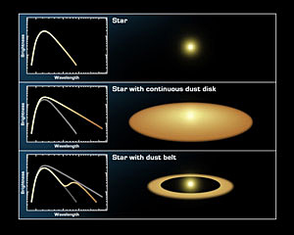
Why do we care?
Stars with debris disks are indicators of planetary systems
Correlation between stellar properties and debris disks

Slide 4
Data
Data taken from Spitzer Space Telescope
  24μm and 70μm
Wide-field Infrared Survey Explorer (WISE)
  3.4μm, 4.6μm, 12μm, 22μm
Ground-based optical and near-infrared (BVK) photometry
  .445μm, .551μm, 2.19μm

Slide 5
Analysis
Spitzer data taken from an NAU survey of 978 stars
WISE data and BVK photometry taken from online databases
  IRSA, SIMBAD, VISIER

Slide 6
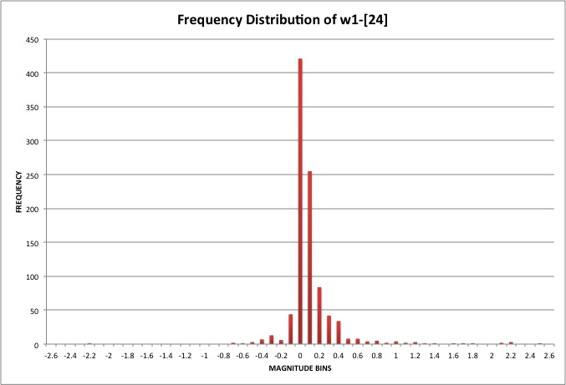
Analysis
WISE 1 used as photospheric estimation
Subtracted off longer wavelength bands to look for excess emission

Slide 7
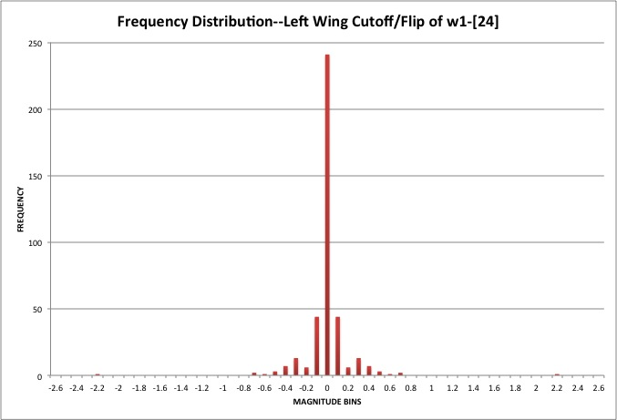
Analysis
Photospheric uncertainty flipped to find σ

Slide 8
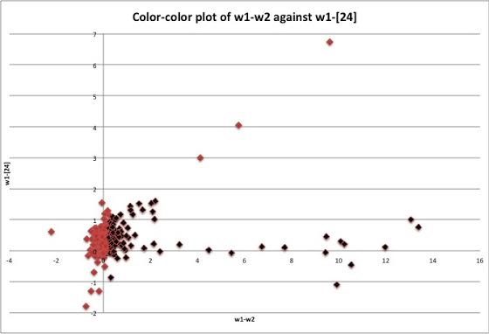
Results
Stars 3σ or greater above photospheric emission compiled in a list of debris disk candidates
Preliminary results
  146 stars at 24μm
  193 stars at 70μm

Slide 9
Remaining Work
Saturation of WISE data (brightest stars)
Misidentification of WISE targets
Small % of objects w/these issues--need to be fixed before results can be finalized

Slide 10
Thank you!
Dr. Koerner
Nadine Barlow & Kathleen Stigmon
NASA’s Space Grant program
Arizona Space Grant Consortium

